Slide 1

Multi-Object Tracking Using Depth - Group 10
Allan Cheboiwo #73661290, Tarek Alkabbani #84930239, Haoyu Wang #42343871, Vanessa Laurel Hariyanto #72484546

Slide 2
Outline
Introduction
System Design
Results
Conclusion and Future Work

Slide 3
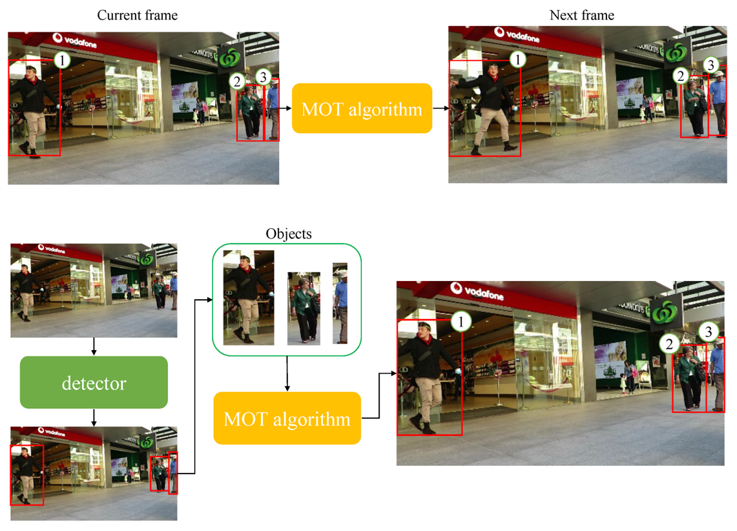
Introduction
Multiple Object Tracking (MOT) :
Track multiple objects in a video and represent them as a set of trajectories with high accuracy.
Park, Y., Dang, L. M., Lee, S., Han, D., & Moon, H. (2021). Multiple Object Tracking in Deep Learning Approaches: A Survey. Electronics, 10(19), 2406. https://doi.org/10.3390/electronics10192406

Slide 4
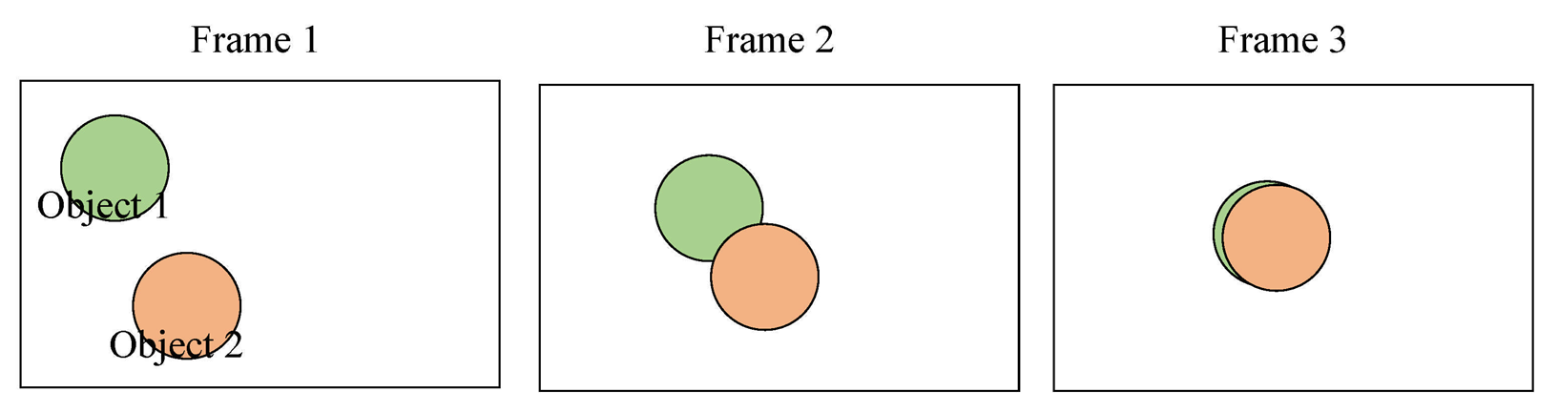
Introduction
Occlusion: The problem that one object partially or fully blocks another in the same frame.
Park, Y., Dang, L. M., Lee, S., Han, D., & Moon, H. (2021). Multiple Object Tracking in Deep Learning Approaches: A Survey. Electronics, 10(19), 2406. https://doi.org/10.3390/electronics10192406

Slide 5
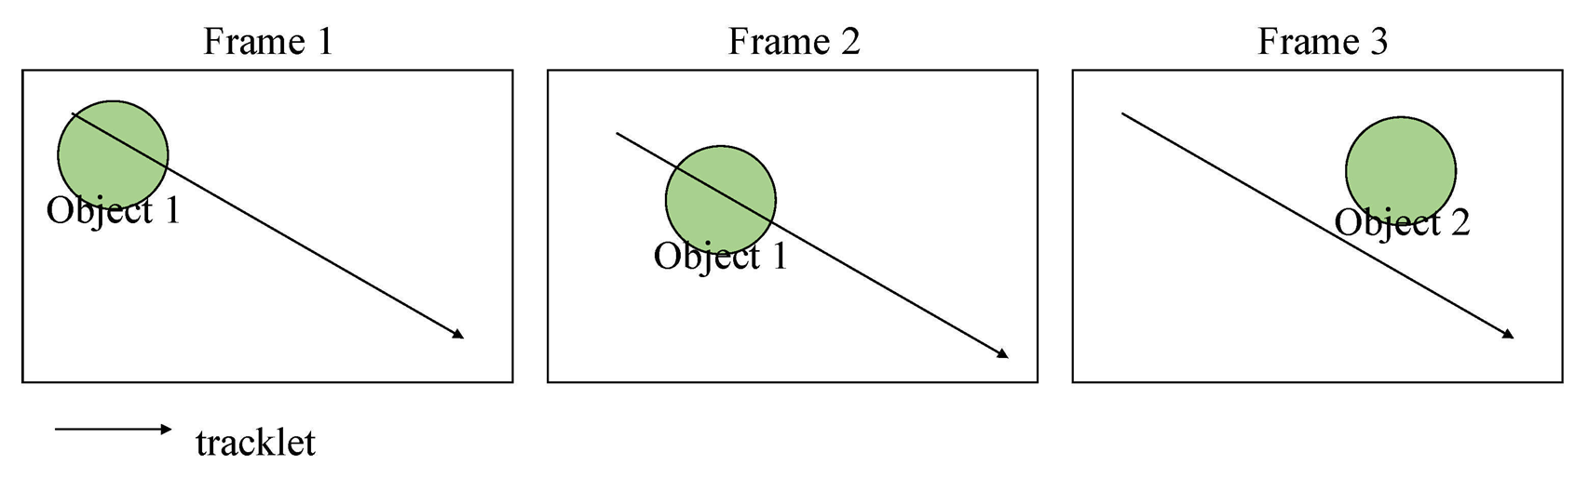
Introduction
ID switch: The problem of assigning a new ID to the same object.
Park, Y., Dang, L. M., Lee, S., Han, D., & Moon, H. (2021). Multiple Object Tracking in Deep Learning Approaches: A Survey. Electronics, 10(19), 2406. https://doi.org/10.3390/electronics10192406
Notes:
And because occlusion exists, ID switch is more likely to happen. Because occlusion may lead to inaccurate tracklet prediction of the object

Slide 6
Introduction
Inspired by several work on 3D multi-object detection, we considered integrating depth information into traditional 2D multi-object tracking algorithms.
Notes:
So in order to solve the ID switch problem caused by occlusion,Inspired by some work on 3D multi-object detection, we considered integrating depth information into traditional 2D multi-object tracking algorithms.

Slide 7
System Design - Extended SORT
We extended the SORT algorithm to include depth information
Our hypothesis was that it would help it perform better under occlusion
Our Program is divide into two parts
Object and Depth Detection
Tracking

Slide 8
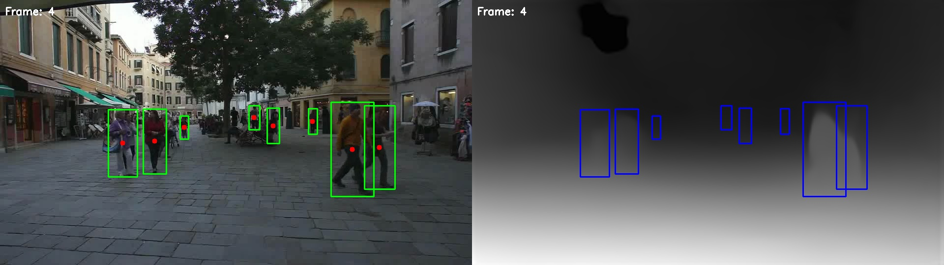
System Design - Object and Depth Detection
For object detection we used YOLOv8s
This gave us the bounding boxes for each object detected
We then use MiDas model for depth estimation
We used the information to create the object descriptors
This was passed then to our tracker

Slide 9
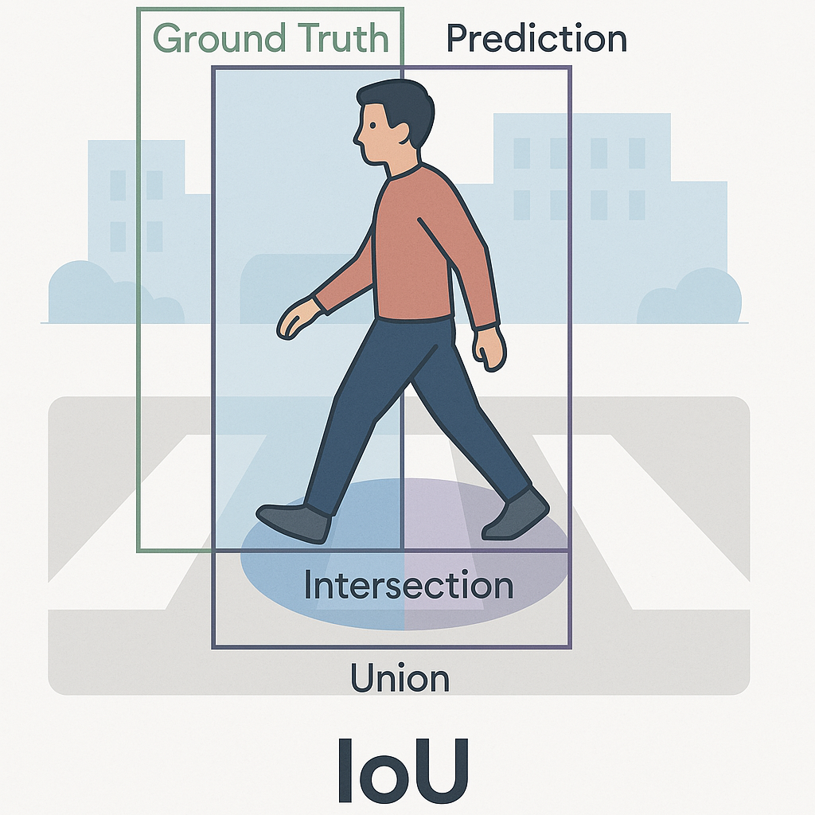
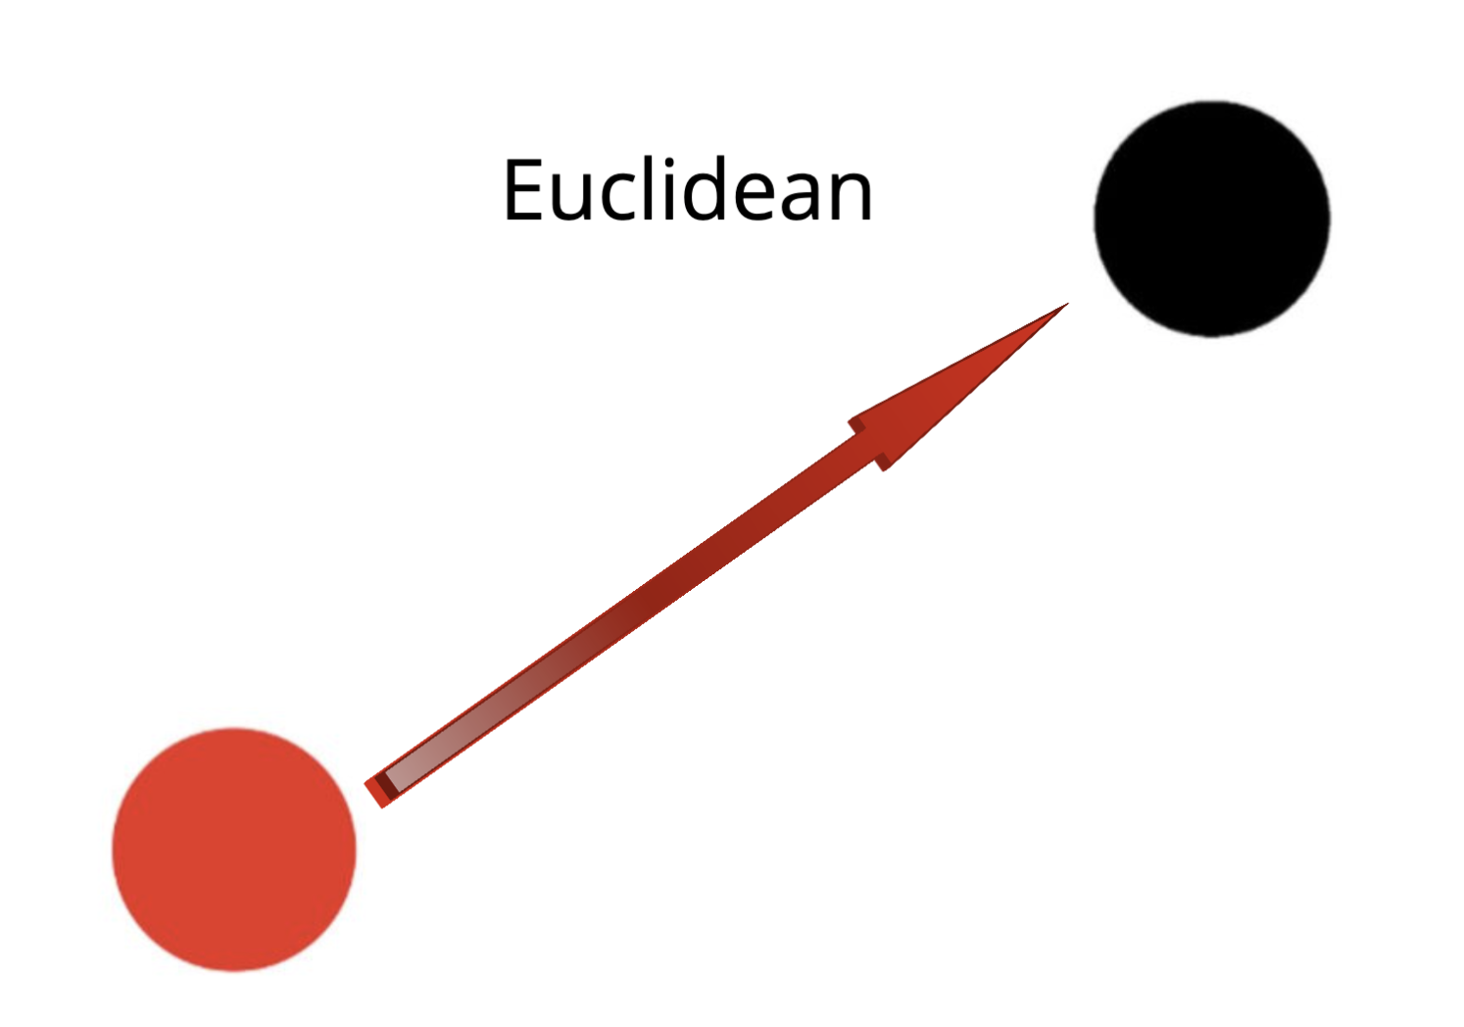
System Design - Tracking
Used Kalman Filtering and Hungarian Algorithm for tracking
These are traditional Computer vision approaches
Kalman Filter makes prediction of where tracked objects will in next frame
Hungarian Algorithm does the matching based on a similarity measure
We used both IoU and Euclidean distance as measures of similarity

Slide 10
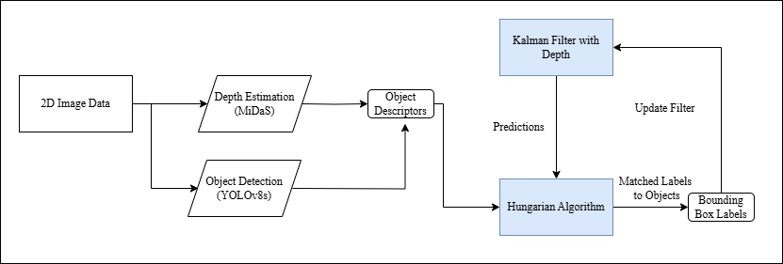
System Design - Overall Design

Slide 11
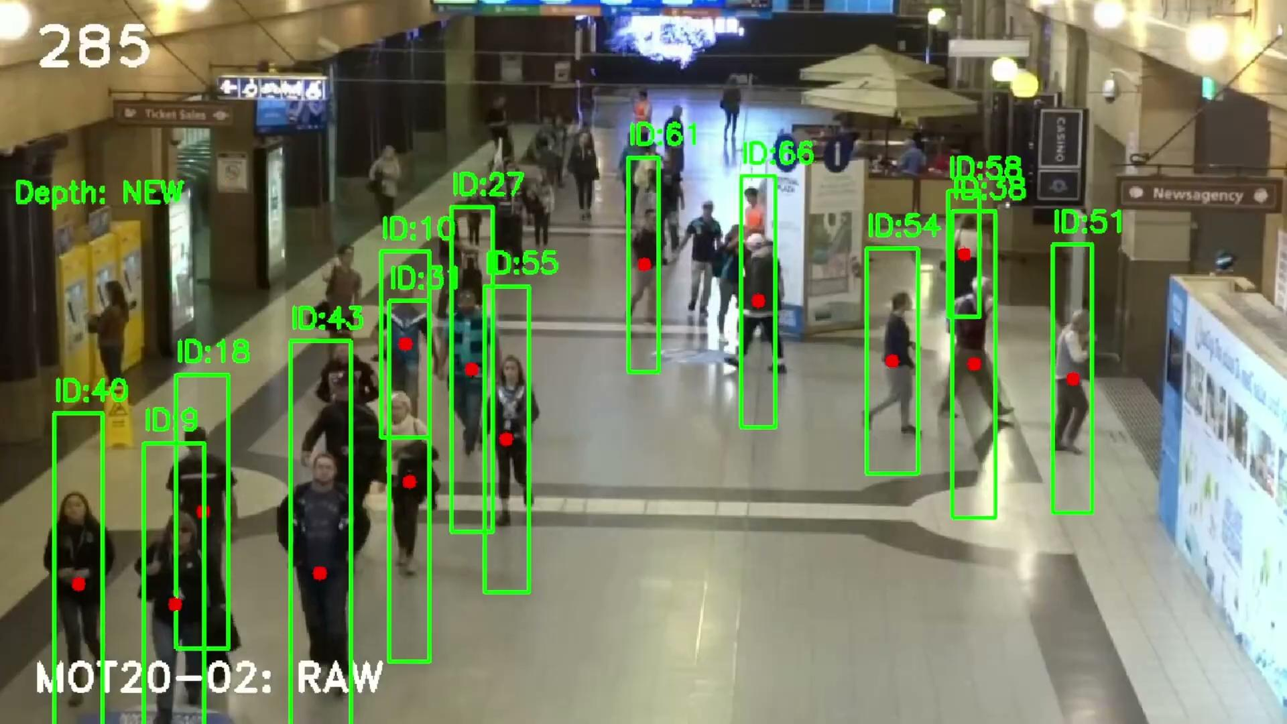
Results
Notes:
Our method successfully incorporated depth information into detection, demonstrating feasibility despite performance limitations."

Slide 12

Results
Notes:
Here is the quantitative comparison of our implementations with other tracking algorithms:
Our algorithm underperforms compared to other tracking algorithms except on the IDs metric. The table below illustrates the performance of various tracking algorithms, showing that while our approach does not perform well in HOTA, MOTA, and IDF1, it does significantly reduce ID switches."
The main reasons for our algorithm's underperformance include:
Mismatch between 3D implementation and 2D dataset: MOT17 is a 2D benchmark, and our 3D approach struggles to align properly.
Noise from MiDas depth information: This affects descriptor quality, impacting tracking accuracy.
Consistency with prior studies: The original SORT research also highlighted that tracking performance depends heavily on the quality of the detector."
HOTA: Measures both detection and association accuracy.
MOTA: Accounts for detection accuracy and ID switches.
IDF1: Evaluates identity preservation across frames.
IDs: Counts the number of ID switches. For HOTA, MOTA, and IDF1, higher values indicate better tracking, while for IDs, a lower value is preferred.

Slide 13
Conclusion & Future Work
Euclidean distance-based tracking outperforms IoU-based tracking.
Our method lags behind state-of-the-art algorithms due to dataset mismatch and depth noise.
It shows promise in minimizing ID switches, which could be beneficial in specific tracking scenarios.
Method needs to be validated further by testing with consistent depth and detection information.
Creating high-quality 3D datasets for pedestrian scenarios
Notes:
In conclusion, our 3D Multiple Object Tracking system showed potential in reducing ID switches but struggled with alignment to a 2D benchmark. To enhance performance, future work should focus on incorporating high-quality 3D datasets, improving dataset diversity, and leveraging synthetic data. Additionally, optimizing for edge devices and exploring transformer-based models could improve efficiency and accuracy in real-world applications such as autonomous driving, surveillance, and smart city analytics."

Slide 14
REFERENCES
Park, Y., Dang, L. M., Lee, S., Han, D., & Moon, H. (2021). Multiple Object Tracking in Deep Learning Approaches: A Survey. Electronics, 10(19), 2406. https://doi.org/10.3390/electronics10192406
Bewley, A., Ge, Z., Ott, L., Ramos, F., & Upcroft, B. (2016, September). Simple online and realtime tracking. In 2016 IEEE international conference on image processing (ICIP) (pp. 3464-3468). Ieee.

Slide 15


Github Repo
https://github.com/COSC444-GROUP10/depthmot

